Slide 1


Developing a Data-Driven Personalized Fitness Web Application for Obese and Sedentary Individuals
Rukayat Balogun |
Dr. Celestine Iwendi |
Masters in Data Analytics and Technology

Slide 2
Introduction
The World Health Organization (WHO) has officially designated obesity as the most significant danger to the health of westernised countries. According to WHO, around 40% of adults in the United States are categorised as obese.
Increasing rates of obesity and sedentary behavior globally lead to chronic health issues like cardiovascular diseases, diabetes, and hypertension
Traditional fitness systems lack personalization, resulting in poor adherence and suboptimal outcomes for individuals with specific needs such as obesity

Slide 3
Research Objective
1. Collect user data for tailored fitness and dietary recommendations.
2. Develop a machine learning model to predict BMI and provide fitness and dietary recommendations.
3. Ensure the platform is accessible and user-friendly.
4. Evaluate the application through user feedback and engagement data.

Slide 4
Research Questions
1. How can user data be leveraged for personalized fitness recommendations?
2. What machine learning techniques can predict BMI effectively?
3. How user-friendly and accessible is the web application for obese and sedentary individuals?

Slide 5
Research Methodology
Model API
User Input
Data Preprocessing
- Data Collection: Primary data via web forms, secondary data from the American Time Use Survey (ATUS).
- Machine Learning Models: Linear regression, Ridge regression, Random Forest, and Gradient Boosting to predict BMI.
- Web Development: Built using Python’s Django framework.
Recommendation
Database

Slide 6
Research Implementation
API
- Backend: Data collection and storage using Django forms.
- Machine Learning Integration: Models predict BMI based on user input, generating real-time recommendations.
- Frontend: User-friendly web interface providing personalized fitness and dietary plans.
Django ORM
Django Template

Slide 7
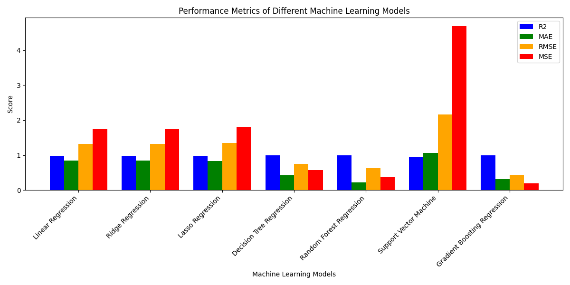
Result
- Model Performance: Gradient Boosting model outperformed others, with an MSE of 0.1868 and 92.5% accuracy.
- User Engagement: Positive feedback from initial users, with improvements in engagement and adherence to personalized plans.

Slide 8
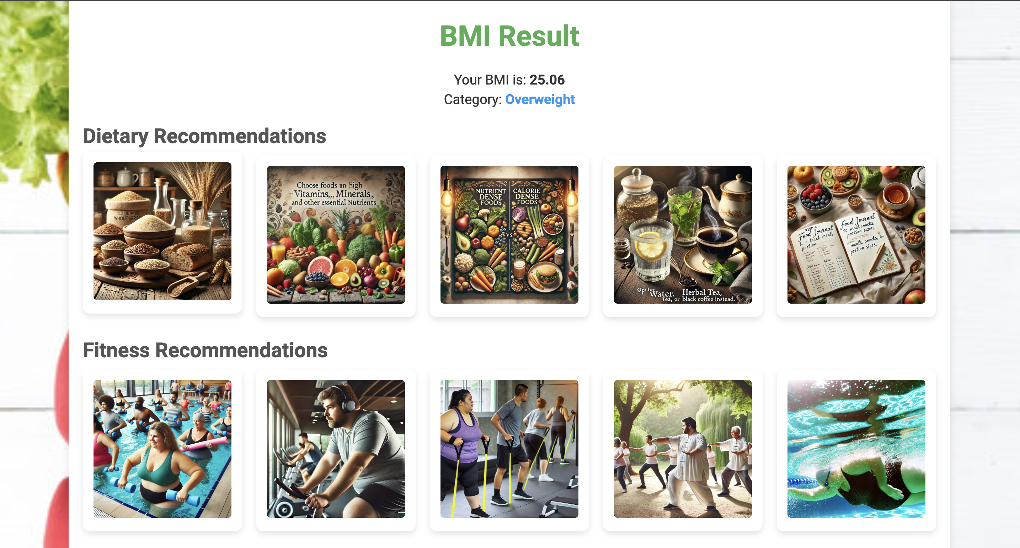
Conclusion and Future Work
Conclusion: Personalized fitness applications can significantly enhance user engagement and improve health outcomes for obese and sedentary individuals.
Future Work:
Include mobile app integration.
Add real-time tracking using wearables.
Expand recommendations to include mental health and lifestyle changes.

Slide 9
Prior Research Vs Current Research
Prior Research:
Traditional fitness recommendation systems using general exercise and diet plans without personalization (Thomas et al 2024b).
Limited integration of data analytics or machine learning for obesity and sedentary lifestyle management (Watt et al., 2024).
Use of static, one-size-fits-all fitness and dietary guidelines, leading to poor user engagement and adherence (Agrawal 2024).
Current Research:
Development of a data-driven personalized fitness application specifically for obese and sedentary individuals.
Machine learning integration for personalized exercise and dietary recommendations.
Real-time adjustments based on user input and continuous data collection.

Slide 10
Conclusion

Slide 11
References
Agrawal, S. (2024). Revolutionizing Cardiovascular Health: A Machine Learning Approach for Predictive Analysis and Personalized Intervention in Heart Disease. International Journal for Research in Applied Science and Engineering Technology, 12(3), pp.233–246.
Thomas, D.M. et al. (2024b). Transforming Big Data into AI-ready data for nutrition and obesity research. Obesity, 32(5), pp.857–870.
Watts, J. et al. (2024). Adapting Random Forests to Predict Obesity-Associated Gene Expression. In Proceedings of the Annual International Conference of the IEEE Engineering in Medicine and Biology Society, EMBS. Institute of Electrical and Electronics Engineers Inc., pp. 4407–4410.

